Slide 1
Into to OOP
With pictures
For the first time We have slideshow !!!

Slide 2
Object-oriented programming is a programming paradigm based on the concept of "objects", which can contain data, in the form of fields, and code, in the form of procedures
Object-oriented programming (OOP) refers to a type of computer programming (software design) in which programmers define the data type of a data structure, and also the types of operations (functions) that can be applied to the data structure.
BASIC CONCE{

Slide 3
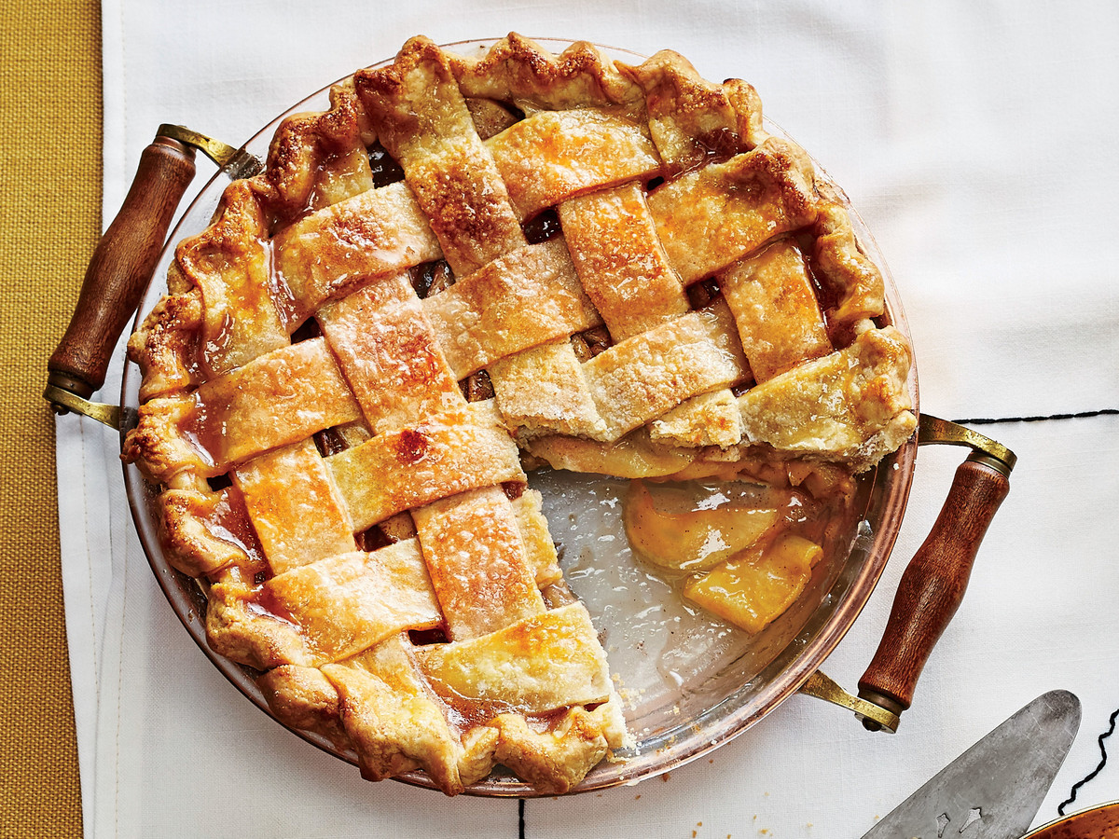

Slide 4
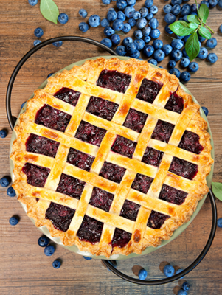
A PIE
Abstraction
Polymorphism
Inheritance
Encapsulation

Slide 5
Abstraction
Meaning: freedom from representational qualities in art.
Examples
Just room, which can be class room or bedroom
Raw meat, which can be used to make soup or BBQ

Slide 6
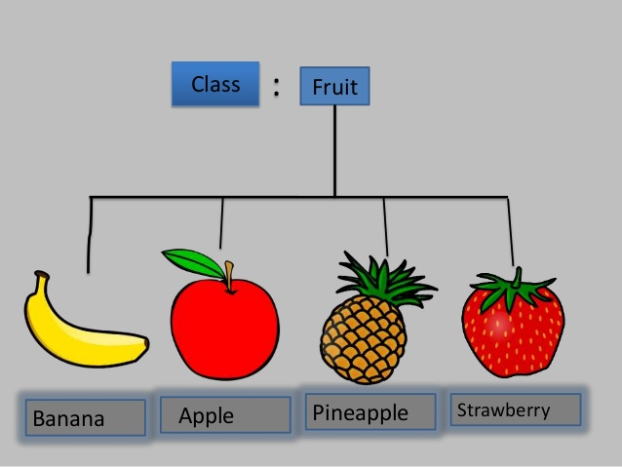
Abstraction

Slide 7
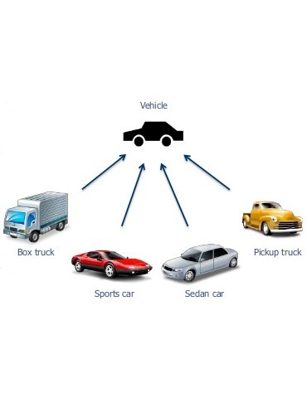
Abstraction

Slide 8
Polymorphism
Meaning: the condition of occurring in several different forms
Changing from one “form” to another “form”
Example:
Everyone has sound
Person can be teacher, father etc.

Slide 9
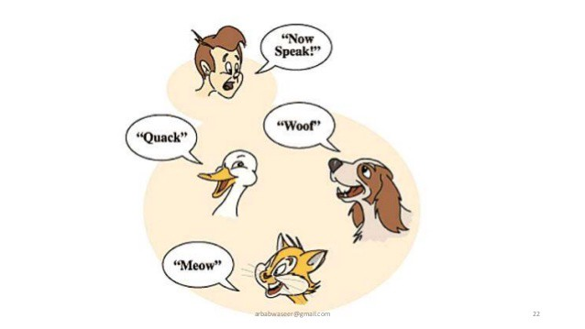
Polymorphism

Slide 10
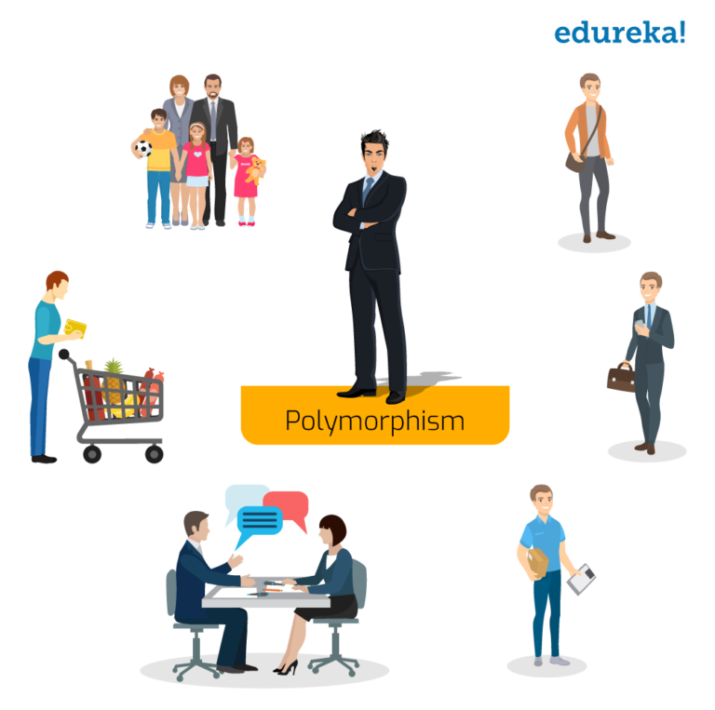
Polymorphism

Slide 11
Inheritance
Meaning: Inheritance is the practice of passing on property, titles, debts, rights, and obligations upon the death of an individual.
Example:
Grandfather, Father, Son
Lion King

Slide 12

Inheritance

Slide 13
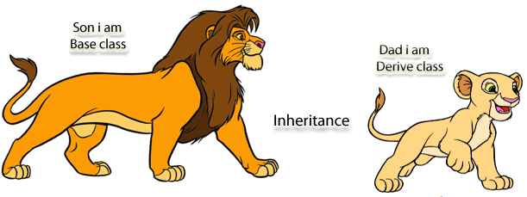
Inheritance

Slide 14
Encapsulation
Meaning: the action of enclosing something in or as if in a capsule.
Example: Pills, Present(Gift)

Slide 15

Encapsulation

Slide 16
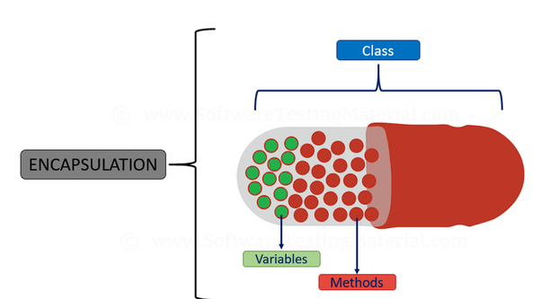
Encapsulation

Slide 17
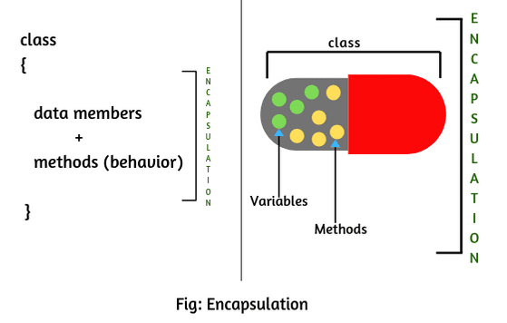
Encapsulation

